Slide 1
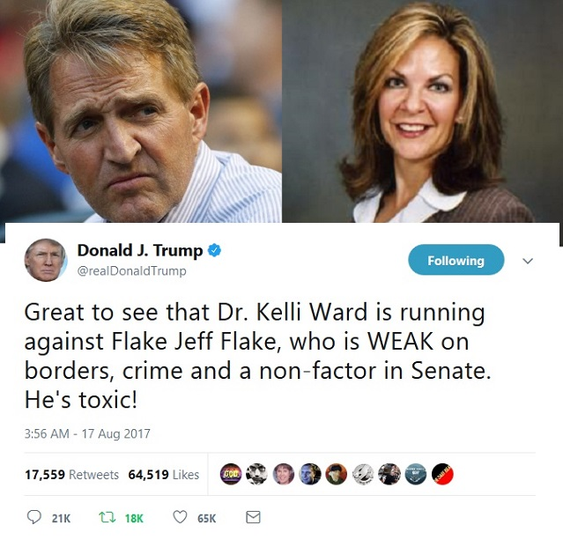
Toxic Tweets
(The group formerly
known as BotsBotsBots)
Rose Gao, Andrea Koch, Ian Lyons
Notes:
Ian

Slide 2
GOALS
Original BotsBotsBots Proposal:
Create a social bot on Twitter which would detect fake news bots
Observe relationship (if any) between bot activity and political events
Toxic Tweets Project:
Analyze several types of toxicity in tweets, focusing on the 2016 US election cycle
Visualize trends in toxicity levels, major political topics, and the political timeline

Slide 3
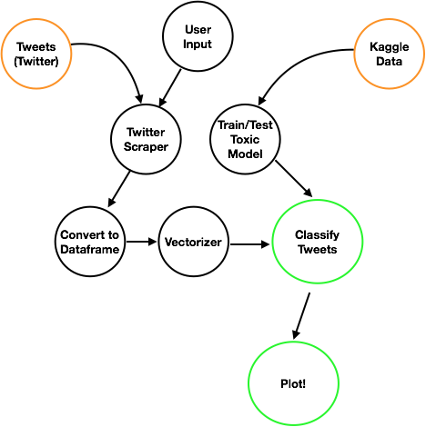
APPROACH
Twitter Scraper:
User provides query (query term, search dates, tweet limit per day, output filename)
Query tweets and export as a csv
Classifier:
Read in the csv as a pandas dataframe
Vectorize the text in each tweet
Use the 6 toxic models to identify levels of toxicity
Visualization:
Create graphs and pull them into a dashboard
Visualize the most compelling insights

Slide 4
INSTRUMENTS
NLP/Classification Libraries Used:
nltk:
Lemmatizer
Tokenizer
sklearn:
TF-IDF Vectorizer
Logistic Regression
Cross Validation Score
scipy:
hstack
Other Libraries Used:
TwitterScraper
Datetime
Plotly (plotting and dashboarding)
With more time, want to use:
Twitter API developer access
Networkx: to map Twitter accounts, tweets, and hashtags

Slide 5
DATA
Kaggle Toxic Comments Dataset
Wikipedia comments rated by human raters for several types of toxic behavior
6 categories: Toxic, Severe Toxic, Obscene, Threat, Insult, Identity Hate
Training data: ~500,000 comments
Tweets: Queried 5 topics from Jan. 1, 2016 - Feb. 28, 2018:
Hillary Clinton
Donald Trump
Gun control
Wikileaks
Abortion (abortion/pro-choice/pro-life)
Vectorized tweet text and classified to get toxicity levels per toxicity category

Slide 6
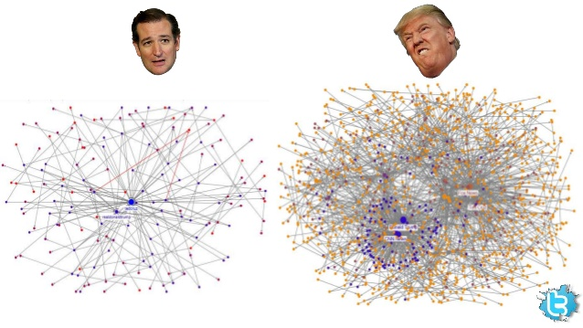
LESSONS LEARNED
Example: Twitter User Network
Bot Detection: need to start with identified accounts, or identify accounts based on behavioral pattern, and expand on the network
Fake News: need to use methods (e.g. neural nets) that can understand and ingest the syntax of words, not just individual words
Syntax is key for the uses of NLP
TwitterScraper is not your best friend, but it is the only one you have

Slide 7
DEMO

Slide 8
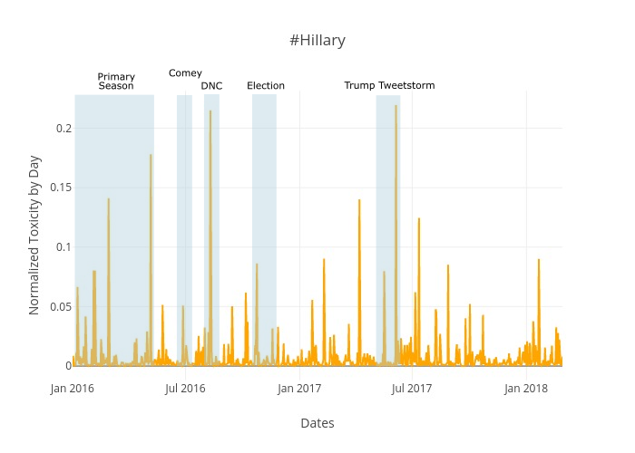
INSIGHTS:
#Hillary

Slide 9
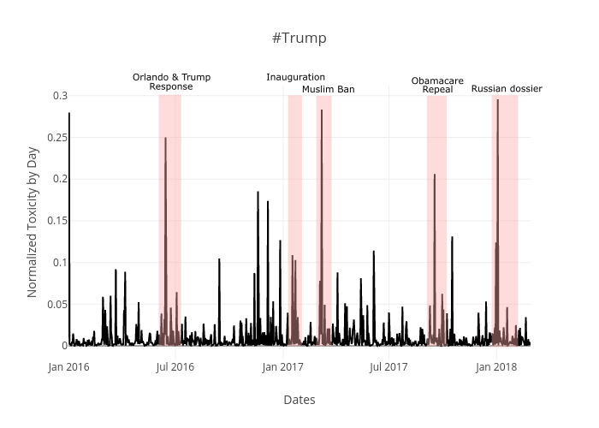
INSIGHTS:
#Trump

Slide 10
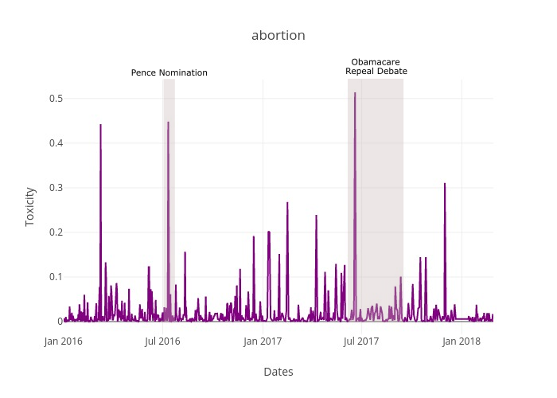
INSIGHTS:
#abortion
#prochoice
#prolife

Slide 11
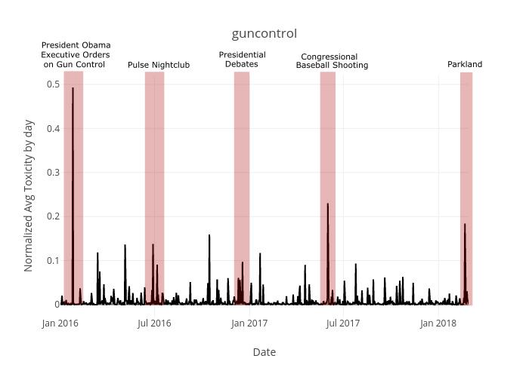
INSIGHTS:
#guncontrol

Slide 12
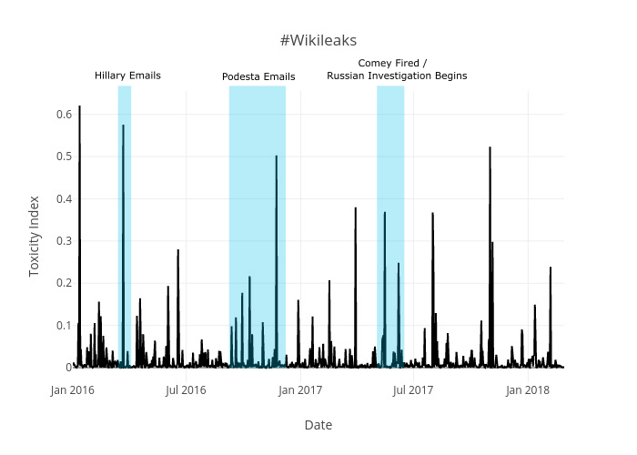
INSIGHTS:
#wikileaks

